Slide 1
Looking at Conference Paper Decision
Machine Learning Team:
Meenu Ravi
Amy Zheng
Qisheng Tang

Slide 2
Introduction
Research paper submissions to academic conferences is been increasing
Using Machine Learning principles for interdisciplinary research is becoming prevalent
How are conference papers evaluated?
And can we automate the evaluation process to decide the acceptance of a paper?

Slide 3
Background and Objective
len_title
len_abstract
1
Number of words in title
2
Number of words in abstract
num_authors
num_conflicts
3
Number of authors
4
Number of comp/uni associated with authors
489 ML papers submitted to 2017 International Conference on Learning Representations (ICLR)
11 variables (integers)
1 binary classification predictor variable: accept/not accepted
num_tags
num_ivy_conflicts
5
Number of hashtags associated with paper
6
Number of authors in ivy league
num_big_four_conflicts
num_keywords_abstract
7
8
Number of authors in Google, FB, Microsoft, Amazon
Number of ML keywords in abstract
num_keywords_title
num_pages
9
10
Number of pages
Number of keywords in title
To analyze and build models to classify whether a conference paper is accepted or rejected
num_sections
decision
11
Number of suctions in paper
12
Accept or not accept

Slide 4
Model and Analysis Plan
Models
Logistic Regression
Random Forest
SVM
Neural Network
Look at 4 classification models
Use dimension reduction, grid search, and voting classifier models to find optimal accuracy score
Analyze accuracy of models and efficiency
Accuracy
Efficiency
Voting
Evaluate

Slide 5
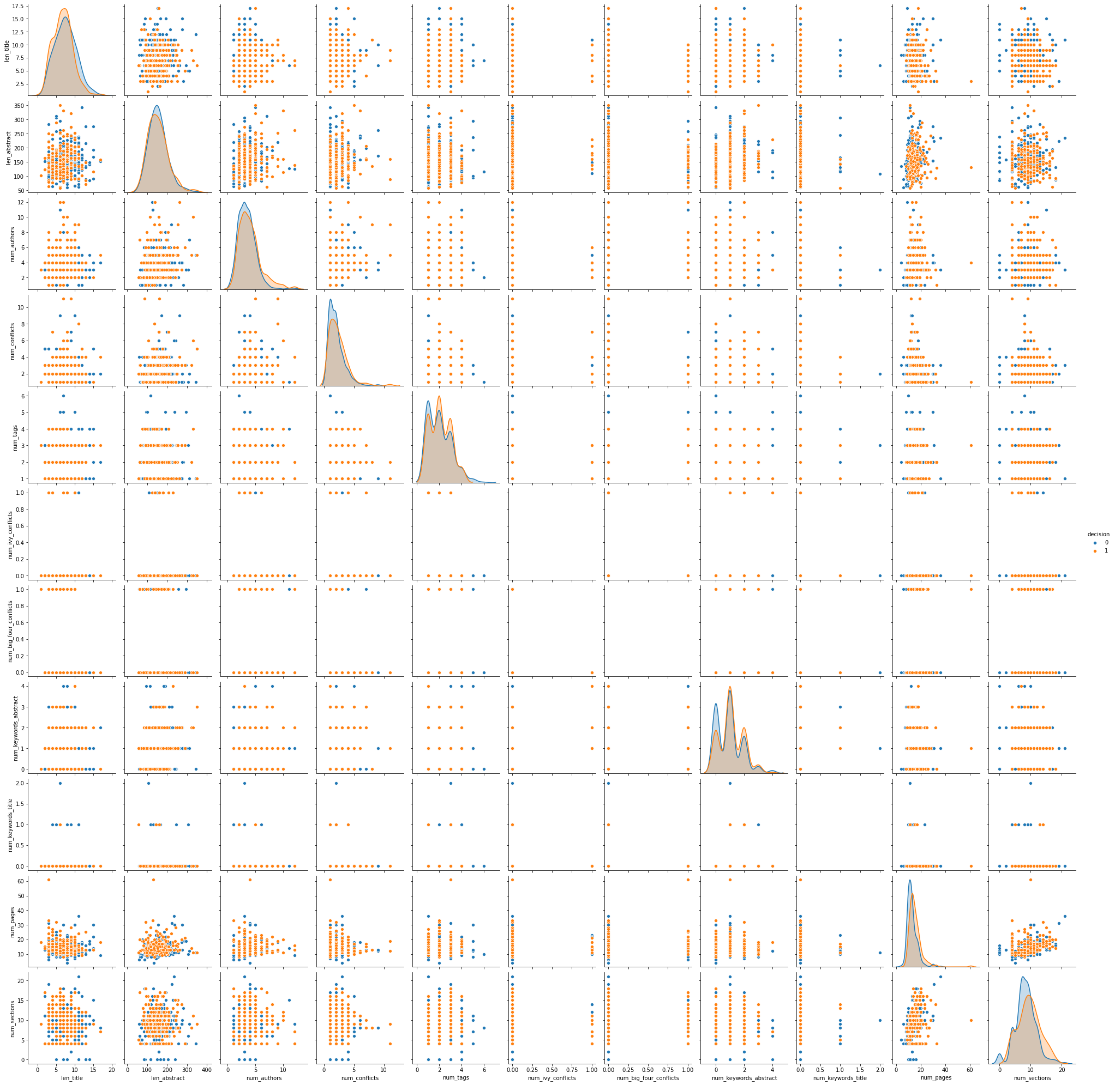
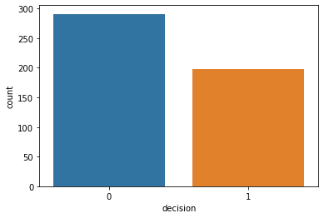
Explore Data Analysis

Slide 6
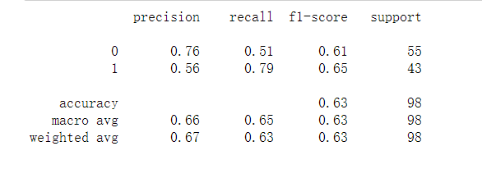
Logistic Regression
Grid Search CV
Param_grid:
C = np.logspace(-3,3,7)
Penalty = [‘L1’,’L2]
Logistic Regression
random_state=42
Accuracy Rate: 0.56
Accuracy Rate: 0.63

Slide 7
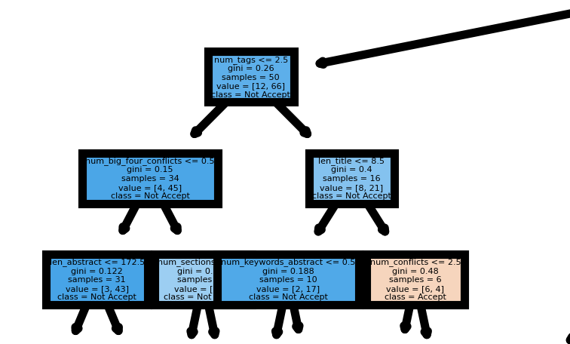
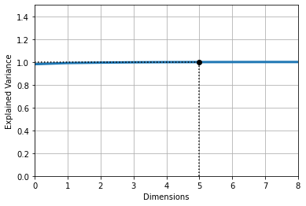
Random Forest
Random Forest
n_estimators=100
random_state=42
Grid Search CV
Param_grid:
n_estimators =
[100,200,400,500]
max_features=
[5,7,9,11]
Principal Component Analysis
n_estimators=
[100,200,300,400,500]
Accuracy Rate: 0.6504
Accuracy Rate: 0.6612
Accuracy Rate: 0.6558

Slide 8
Voting Classifier
Logistic Regression:
0.622
Voting Classifier: Soft Voting:0.633
Hard Voting: 0.602
Data
Random Forest: 0.612
Soft Voting
vs.
Hard Voting
SVM: 0.592
Notes:
Voting classifier methodology utilizes the collective judgment of multiple classifiers for predicting data points

Slide 9
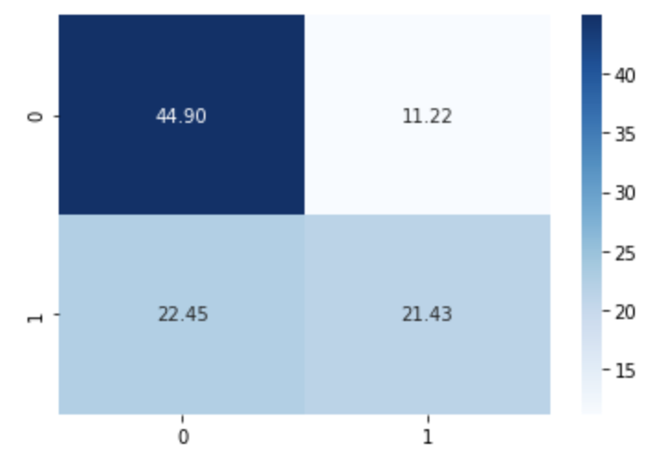
Support Vector Machine(SVM)
Support Vector Machine
Data standardisation:
Scaled X
Kernel = linear
Accuracy = 0.5816
Grid Search CV
Param_grid:
C = [0.01, 0.1, 1, 10,100,100]
Gamma = [100, 10, 1, 0.75, 0.5, 0.25, 0.1, 0.01, 0.001]
Kernel = [linear, poly, rbf, sigmod]
Accuracy = 0.6632
Classification Report
precision recall f1-score support
0 0.67 0.80 0.73 55
1 0.66 0.49 0.56 43
accuracy 0.66 98
macro avg 0.66 0.64 0.64 98
weighted avg 0.66 0.66 0.65 98

Slide 10
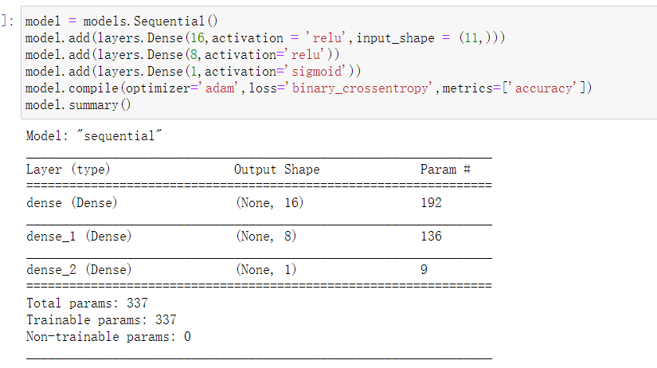
Neural Networking
DNN
Layers = 3
Parameter:
epochs = 20
batch_size = 5
Validation Accuracy : 0.6486

Slide 11
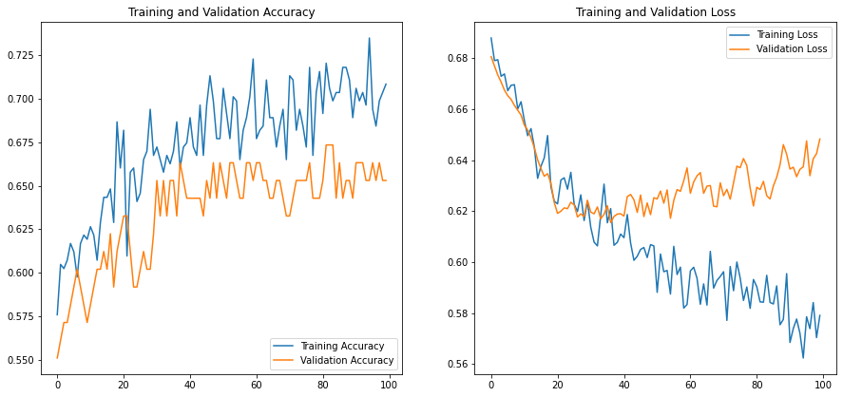
Neural Networking
GridSearchCV
Layers = 3
Parameters:
Epochs：5, 10, 20, 50, 100
Batch_size: 5, 10, 20, 40, 60, 80, 100
Optimizer: 'SGD', 'RMSprop', 'Adagrad', 'Adadelta', 'Adam', 'Adamax', 'Nadam'
Best Parameters:
Epochs = 100, Batch Size = 5, Optimizer = Nadam
Accuracy: 0.66

Slide 12
Model Summary and Analysis
 | Logistic Regression | Random Forest | SVM
Accuracy | 0.64 | 0.661 | 0.663
Voting Classifier | Neural Network
0.633 | 0.66
The lower accuracy rates show that contents of paper are more important than these features

Slide 13
Next Steps
Data and Models
Variables
Collect more data on papers from other ML conferences and from other years
Try to use transfer learning
Look at alternate variables such as:
Number of figures
References: Number and types
Time spent of research
Analysis
Extraction Methods
Extend analysis to other conferences
Current: X model
Future: X model to predict differences in another conference
Current: Used python’s pdf parsing tool for certain features
Future: Use other tools and NLP to automate paper analysis

Slide 14
Appendix
Qisheng
Meenu
Amy
Logistic Regression Slide 6
Random Forest + Slide 7
Voting Classifiers
Slide 8
Neural Network Slide 10,11
EDA slides
SVM Slide 9

Slide 15
Thank You!
Any Questions?

